Slide 1
Agentic AI Hackathon: Building Intelligent Agents with IBM Granite and LangFlow
AI-Driven Traffic Alert And Route Planning System

Slide 2


Name of the team: Invariant
Details of Team members
TEAM MEMBER NAME | Recent Passport Photo | Email ID | Phone number [WhatsApp]
Iha Rao |  | ihaarao@kssem.edu.in | 9972487738
M .Trisha |  | trishamohan1974@gmail.com | 6360887235

Slide 3
Problem Statement
“AI-Driven Early Warning System for Traffic Congestion Hotspots”
  Rapid urbanization has led to frequent traffic congestion hotspots in cities
  Existing systems are reactive, identifying congestion only after it occurs
  Lack of early warning mechanisms prevents timely traffic management actions
  Commuters face increased:
    Travel time
    Fuel consumption
    Stress and uncertainty
  Traffic authorities need predictive insights to proactively manage congestion

Slide 4
Proposed Solution
  Build an AI-driven traffic alert and route planning system using Langflow and IBM watsonx.ai.
  Analyze user inputs (location, time, weather, traffic) through a multi-agent AI architecture.
  Detect congestion early and estimate delay, clearance time, and risk level.
  Generate clear ALERT-based outputs with commuter advice and accurate alternate routes.
  Use Retrieval-Augmented Generation (RAG) to ground responses in traffic guidelines and historical patterns.
  Deliver scalable, explainable, and location-aware traffic intelligence for global use.

Slide 5
Need of project
  Urban traffic congestion causes 20–30% extra travel time for daily commuters in major cities
  In Indian metro cities, peak-hour speeds drop by 40–60% compared to free-flow conditions
  Commuters lose 100–150 hours per year stuck in traffic delays
  Fuel consumption increases by 15–25% due to stop-and-go congestion
  Emergency response times can increase by 30–50% during heavy congestion
  Existing GPS apps react after congestion occurs, ours predicts before hand.

Slide 6
End user of project
  Daily Commuters – to receive real-time traffic alerts and alternate routes
  Office & Corporate Employees – for optimized daily commute planning
  Logistics & Delivery Services – to reduce delivery delays and fuel costs
  Public Transport Operators – for congestion-aware route decisions
  Emergency Services – to identify less congested routes quickly
  Smart City & Traffic Management Authorities – for congestion monitoring and planning.

Slide 7
Technology Used
  IBM watsonx.ai – Foundation models (Granite Model) for traffic intelligence
  Langflow – Visual orchestration of multi-agent AI workflows
  Agentic AI Architecture – Specialized agents for analysis, risk detection, and alerts
  Retrieval-Augmented Generation (RAG) – Context-aware, grounded responses
  Embedding Models – Vectorizing traffic guidelines and knowledge
  Astra DB (Vector Database) – Storage and retrieval of traffic knowledge
  Prompt Engineering – Controlled, structured alert-based outputs

Slide 8
Novelty and Uniqueness
  Agentic AI architecture where each AI agent independently analyzes, predicts, and plans traffic decisions instead of using a single monolithic model.
  Early congestion risk prediction that identifies traffic escalation before severe congestion occurs, not just after it happens.
  Explainable traffic alerts that clearly state why congestion is occurring (time, weather, density, patterns).
  Retrieval-Augmented Generation (RAG) to ground traffic decisions using stored traffic guidelines and historical knowledge, reducing vague guesses.
  Geographically accurate route intelligence that adapts suggestions based on the exact city, area, state, or country mentioned.
  Strict, structured ALERT-based output format, making responses instantly readable and commuter-friendly.

Slide 9
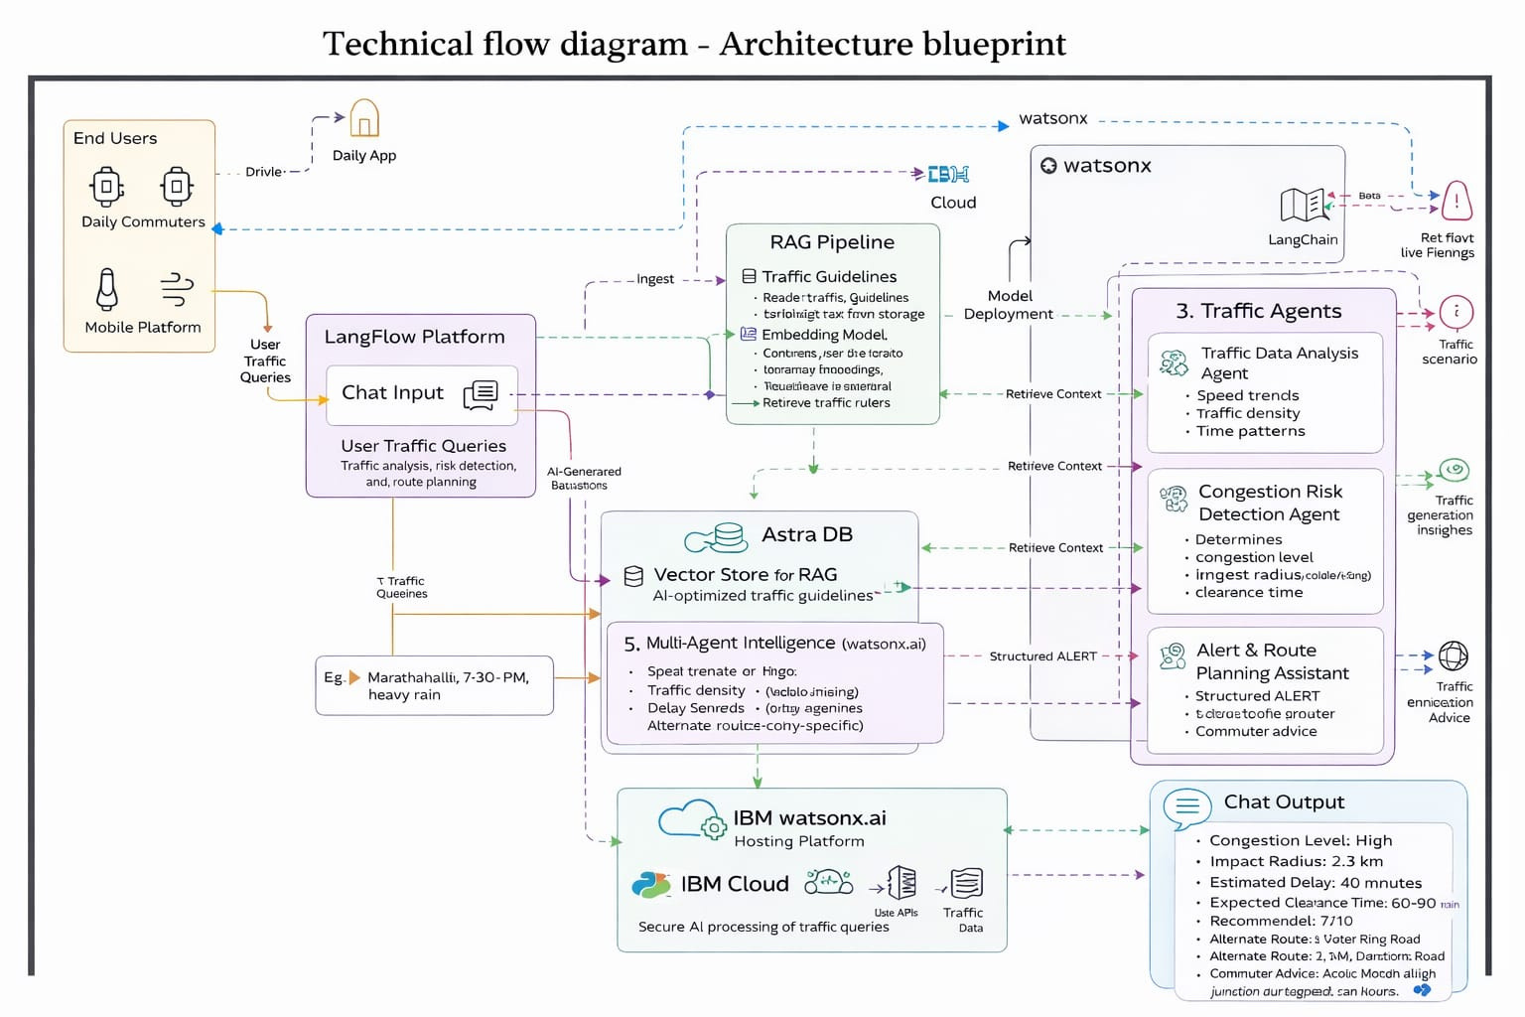
Technical flow diagram - Architecture blueprint

Slide 10
Langflow Components Used
  Chat Input
  Prompt Template
  Language Model (IBM Granite / Watsonx AI)
  Traffic Data Analysis Agent
  Congestion Risk Detection Agent
  Alert & Route Planning Assistant
  Traffic Guidelines File Reader
  Split Text
  Embedding Model
  Vector Store (Astra DB)
  RAG Vector Retriever
  Chat Output

Slide 11
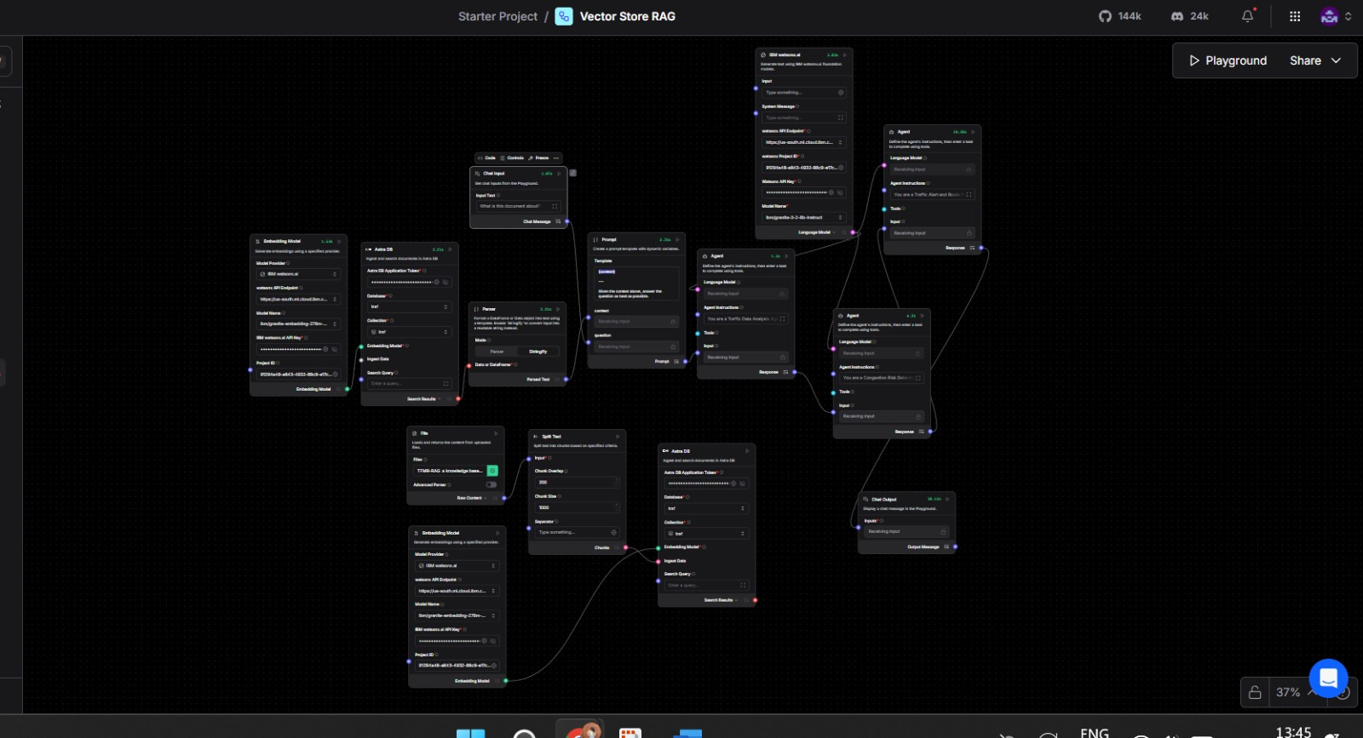
Screenshot 1

Slide 12
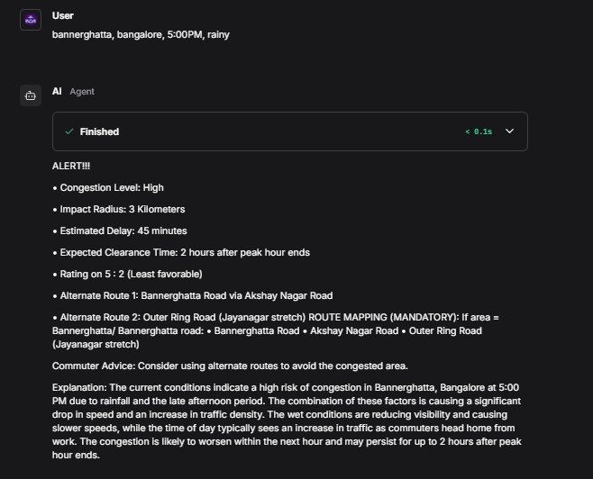
Screenshot 2

Slide 13
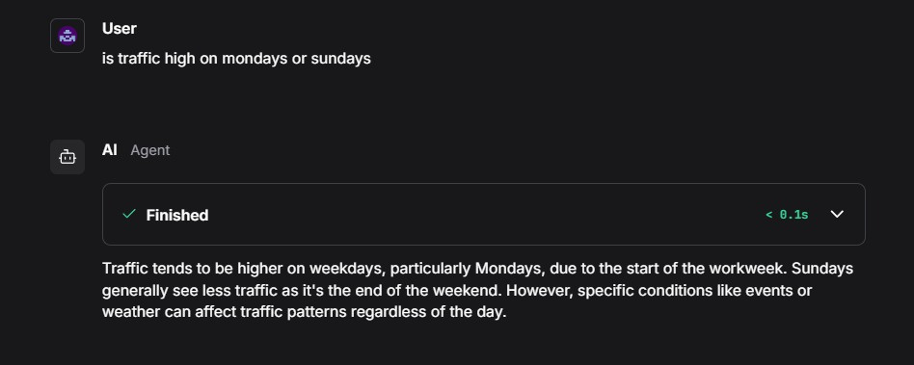
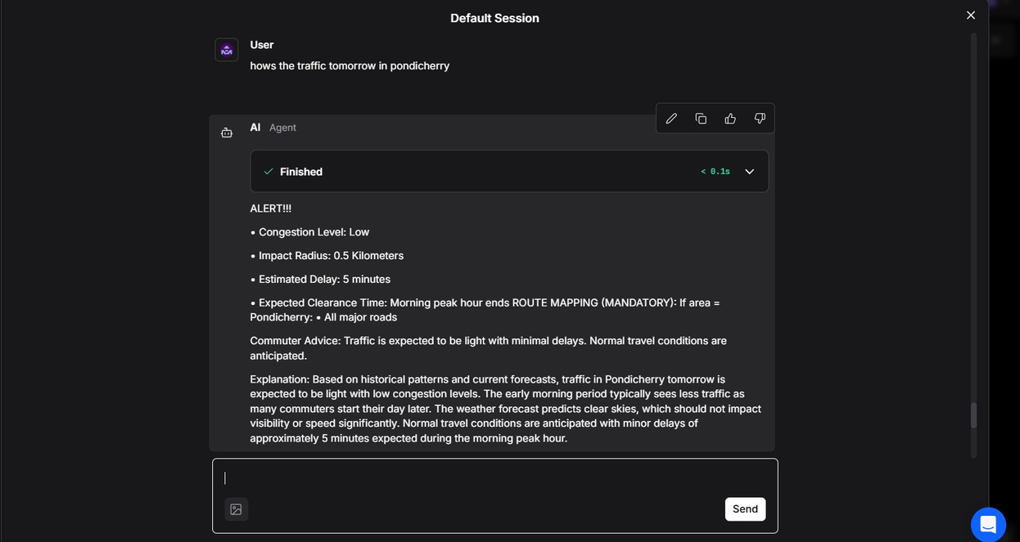
Screenshot 3

Slide 14
Future Scope
  Integrate real-time traffic APIs (Google Maps, TomTom, OpenStreetMap) for live congestion data
  Expand to multimodal routing (metro, buses, ride-sharing, walking)
  Enable voice-based alerts and mobile notifications for commuters
  Deploy as a smart city dashboard for traffic authorities
  Enhance RAG with live sensor, CCTV, and IoT data feeds
  Support global cities with localized traffic rules and road intelligence

Slide 15
Git Hub Link
https://github.com/ihaarao/ai-traffic-alert-routing-system
·
·
·

Slide 16
References
  IBM watsonx.ai Documentation
https://www.ibm.com/docs/en/watsonx-ai
  IBM Granite Foundation Models
https://www.ibm.com/watsonx/granite
  Traffic Congestion Analysis Concepts
https://www.sciencedirect.com/topics/engineering/traffic-congestion
  Urban Traffic Pattern Studies (IEEE)
https://ieeexplore.ieee.org/
  Google Maps Traffic Concepts (Reference only)
https://developers.google.com/maps/documentation

Slide 17


